Slide 1
SP-6 Blue Time Mileage App
Ethan Strickland, Armando Ortiz, Jacob Carrington, David Nguyen, Andrew Millsap

Slide 2


App Overview
Our app allows for users to track and collect their route information and be able to export this data later if wanted
Our app will be monetized using ads and a paid tier of the app

Slide 3





Technologies Used
React Native
JavaScript
Expo
Figma
Firebase
Google Cloud APIs
Google AdMob
Github
Visual Studio
React
Expo

Slide 4

React Native & Expo GO
React Native is an open- source UI software framework that is most used to develop software applications for Android and iOS.
Expo provides a sandbox environment for learning and experimenting with React Native on both Android and iOS devices.

Slide 5
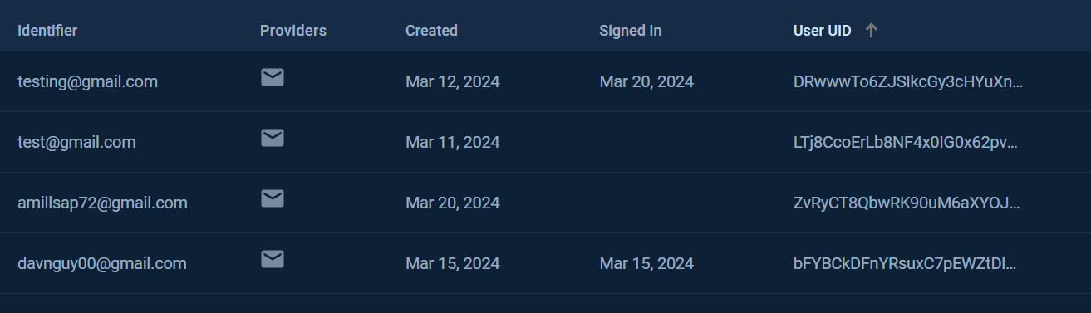
Firebase Authentication
Allows users to create and sign-in to accounts
Simple password reset and two-factor authentication

Slide 6
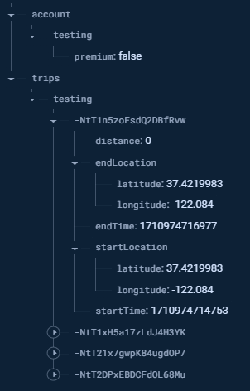
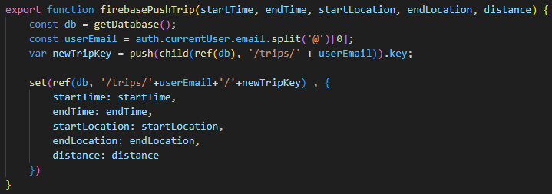
Firebase Realtime Database
Stores information regarding accounts and trips
Account stores premium status
Trips stores information to track individual trips

Slide 7

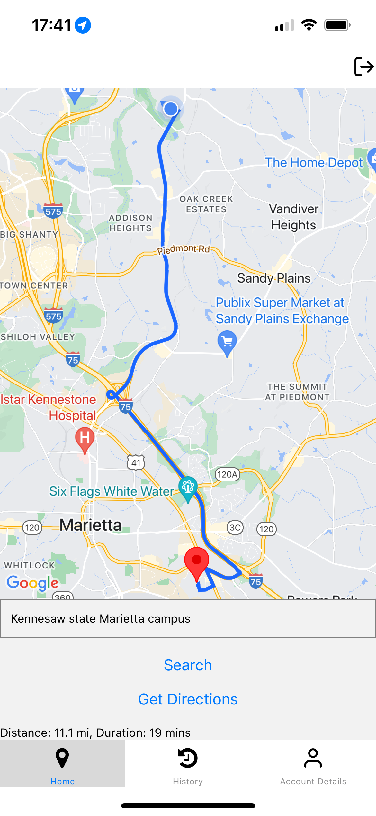
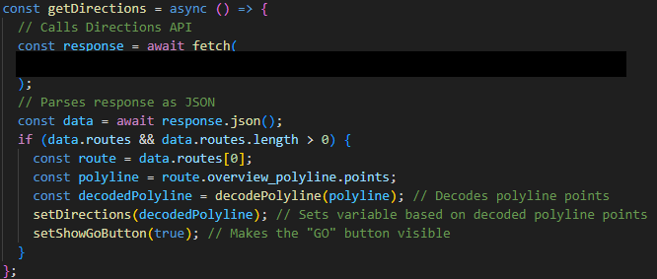
Google Maps API
Places – Allows us to search
Directions – Gets fastest route to location
Distance Matrix – Gets estimated time and distance to location

Slide 8
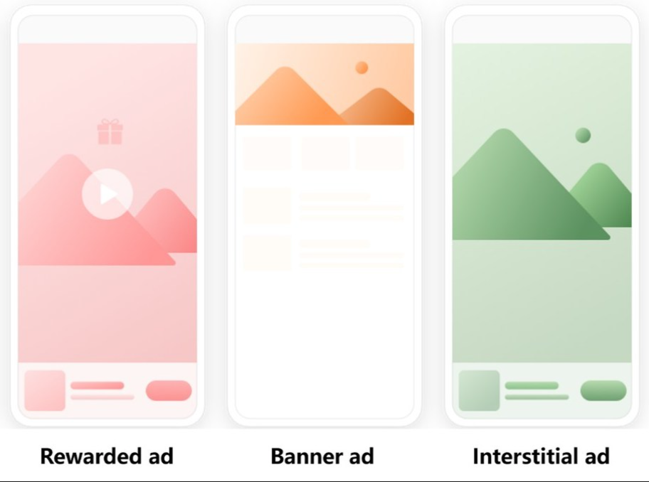
Advertising
The way we decided to monetize our app by implementing advertising
Types of Advertising
Banner Ads
Interstitial Ads
Rewarded Ads

Slide 9

Google admob Implementation
Install react-nativegoogle-mobile-ads into your terminal
Create an AdMob account and get application ID and Ad unit ID
Import the type of Ad you want into the file you want it to show up
Write the code to place the ad in the file
Go to App.json and add the application ID to the file

Slide 10
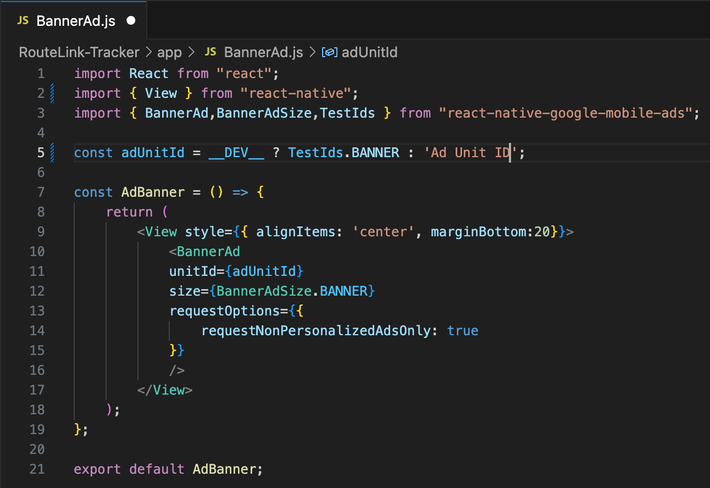
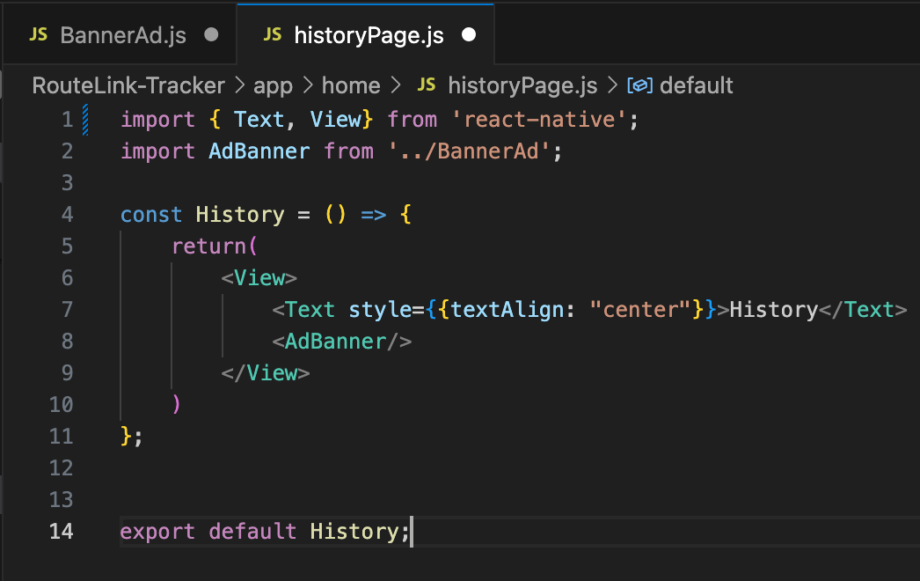
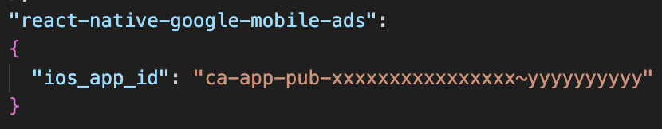
Implementing Google Admob

Slide 11

Phases of subscription Tiers
Phase 1
Free subscription
There will be banner ads displayed throughout the app
Premium subscription
Banner Ads will be removed from the app
Phase 2
Free subscription
Database will only keep 1 year of trip history
Premium subscription
Database will keep 5 years of trip history for the user
Geo Tagging on locations such as home and work

Slide 12
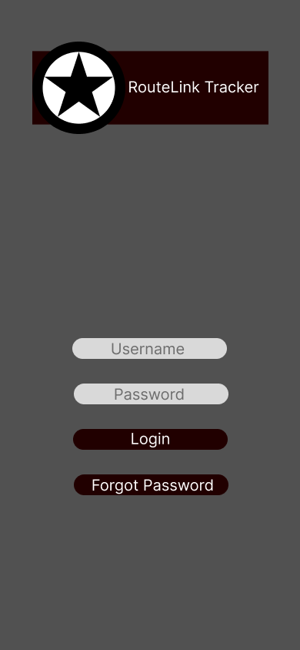
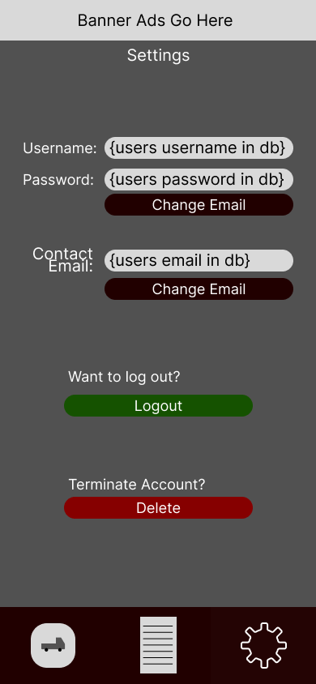
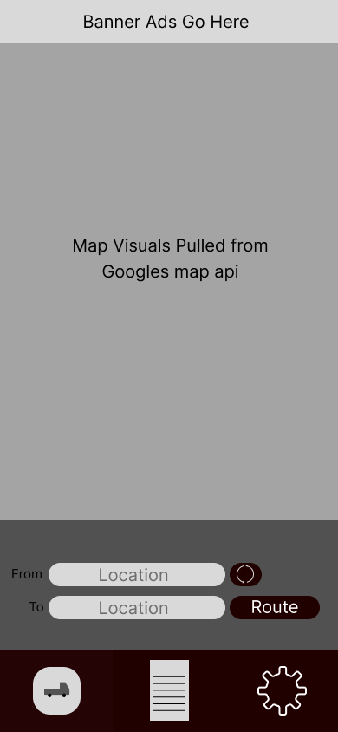
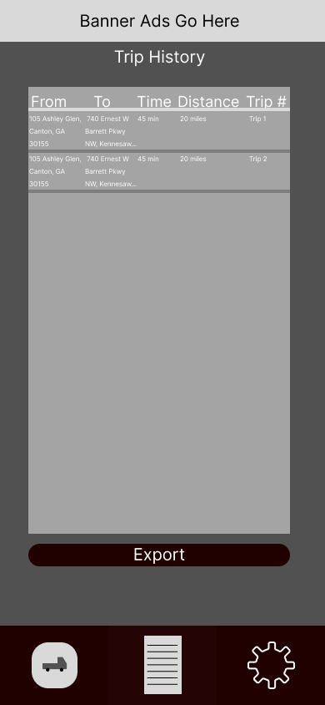
Prototype App Design

Slide 13
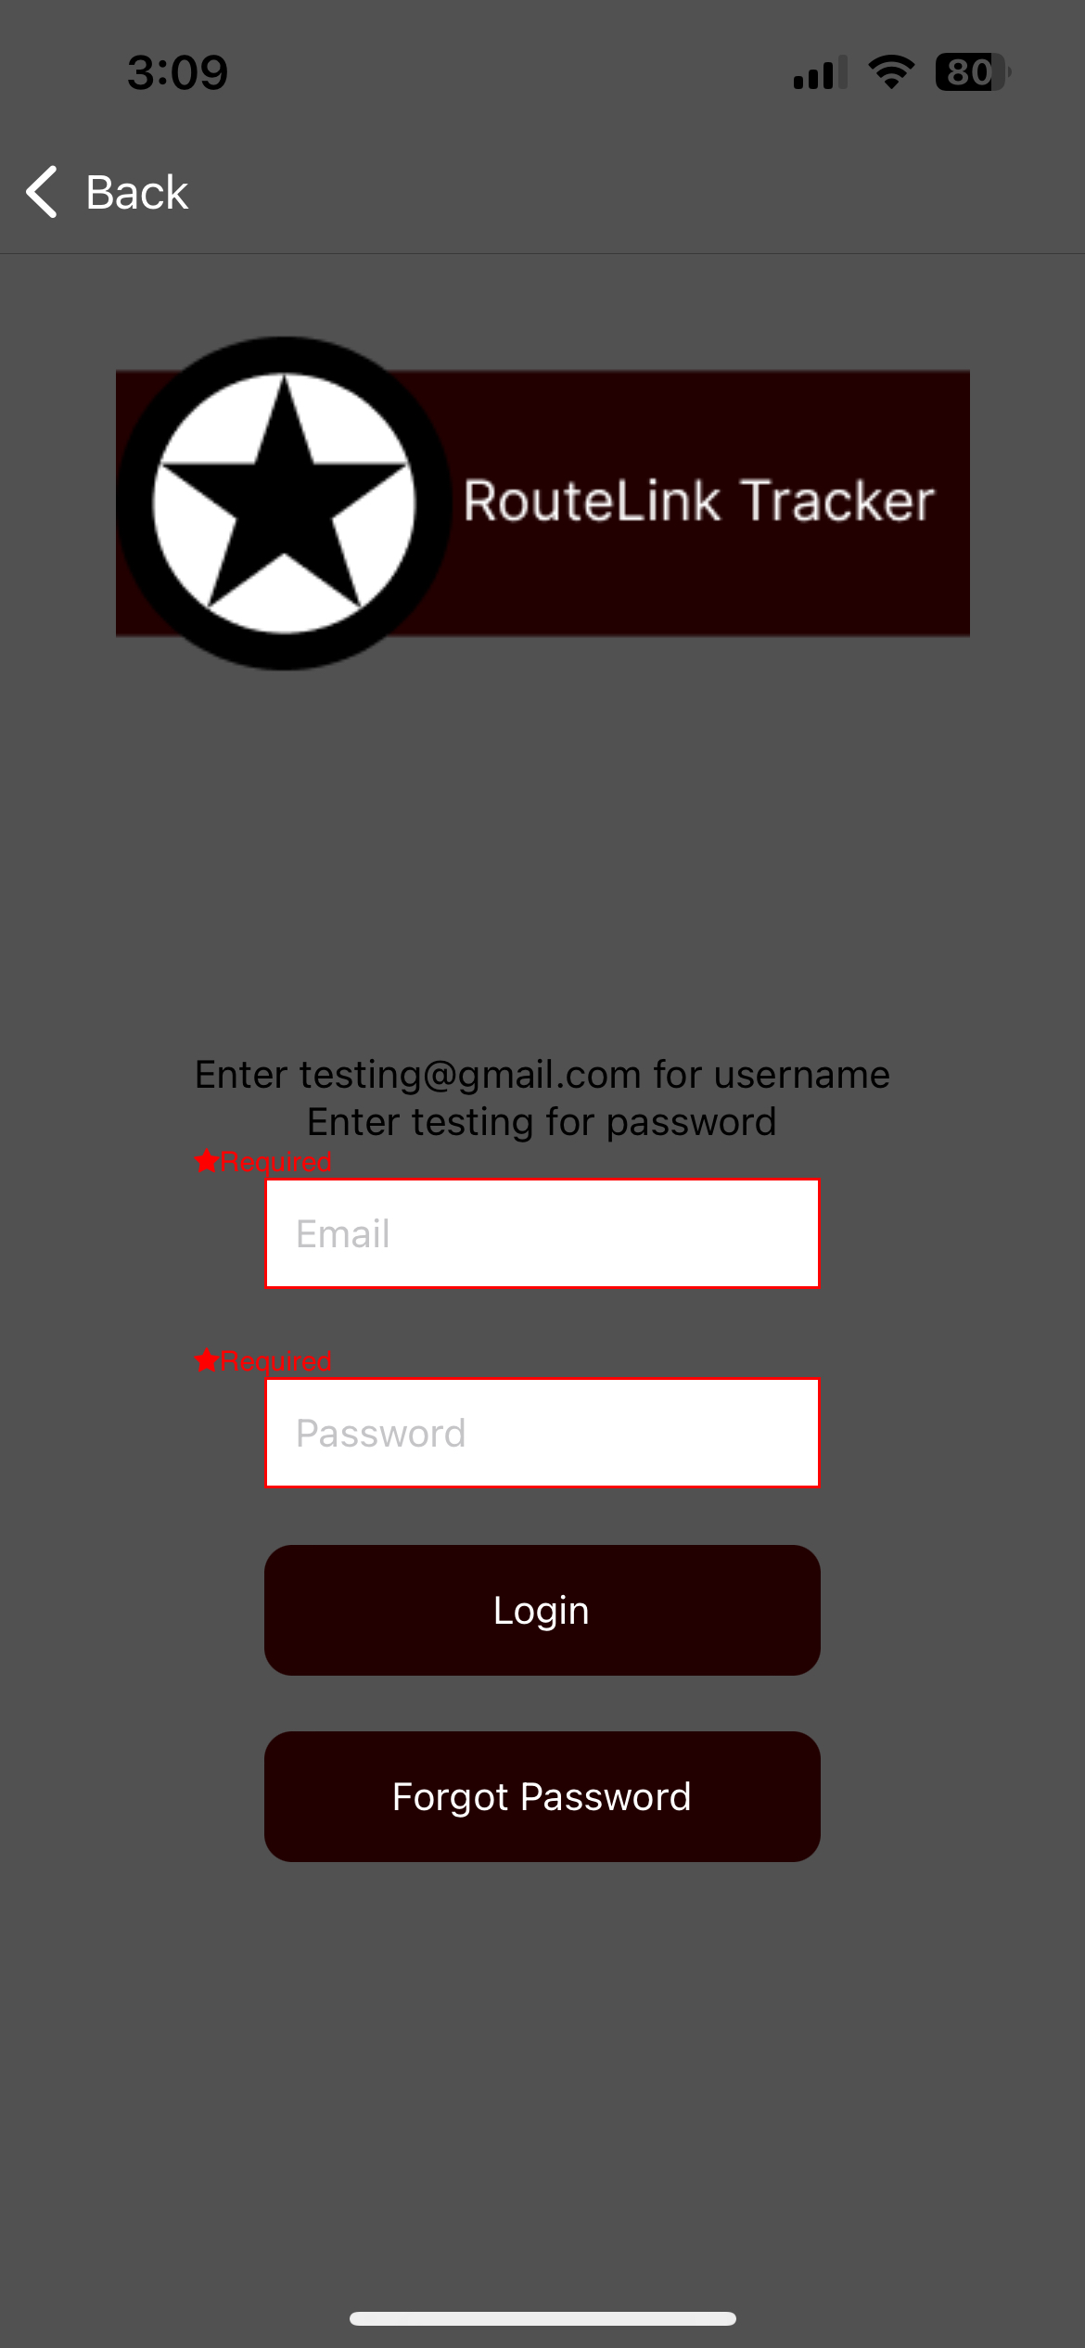
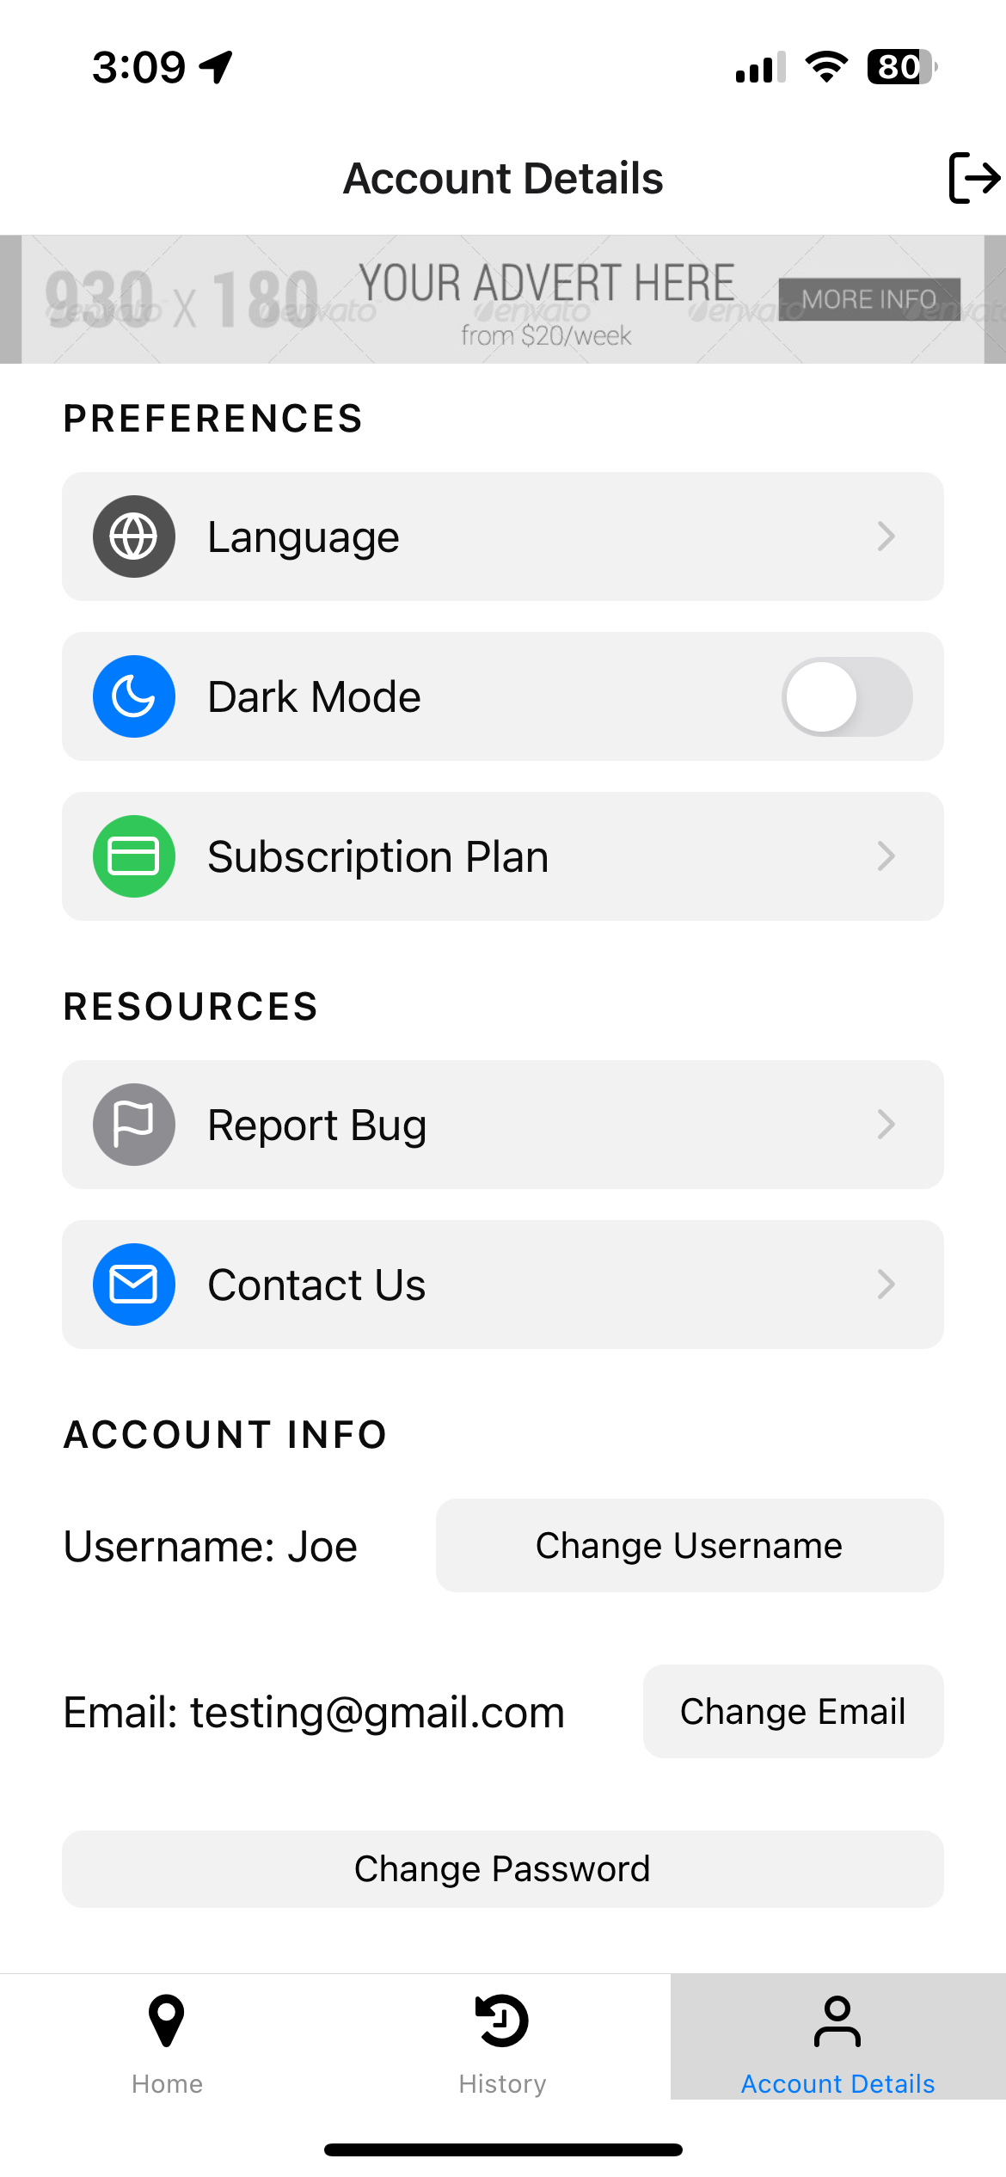
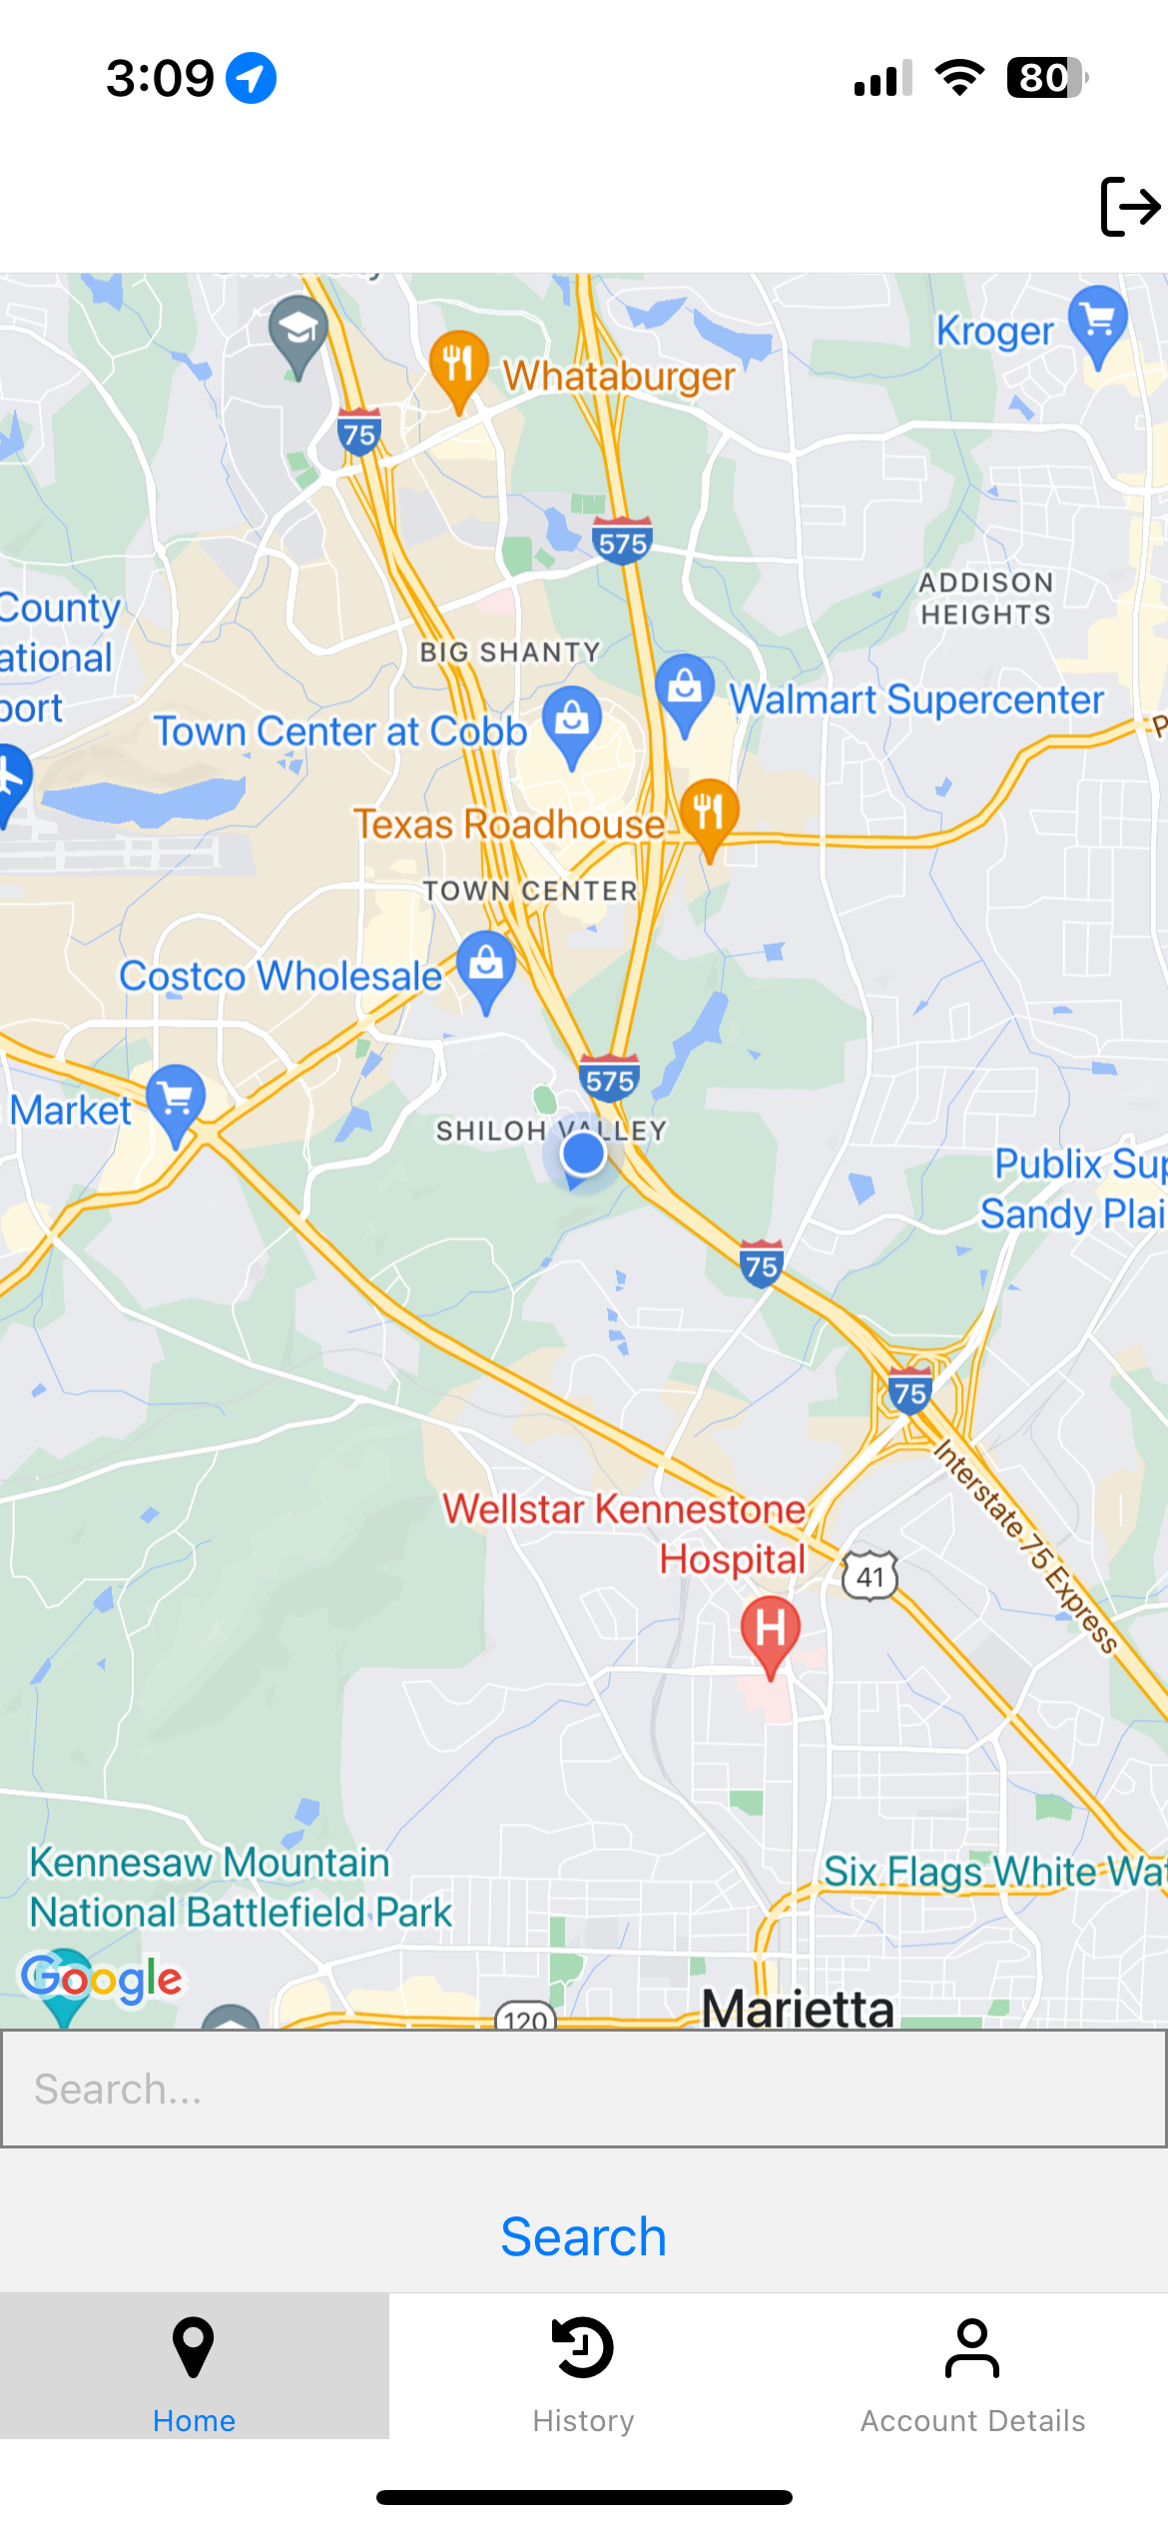
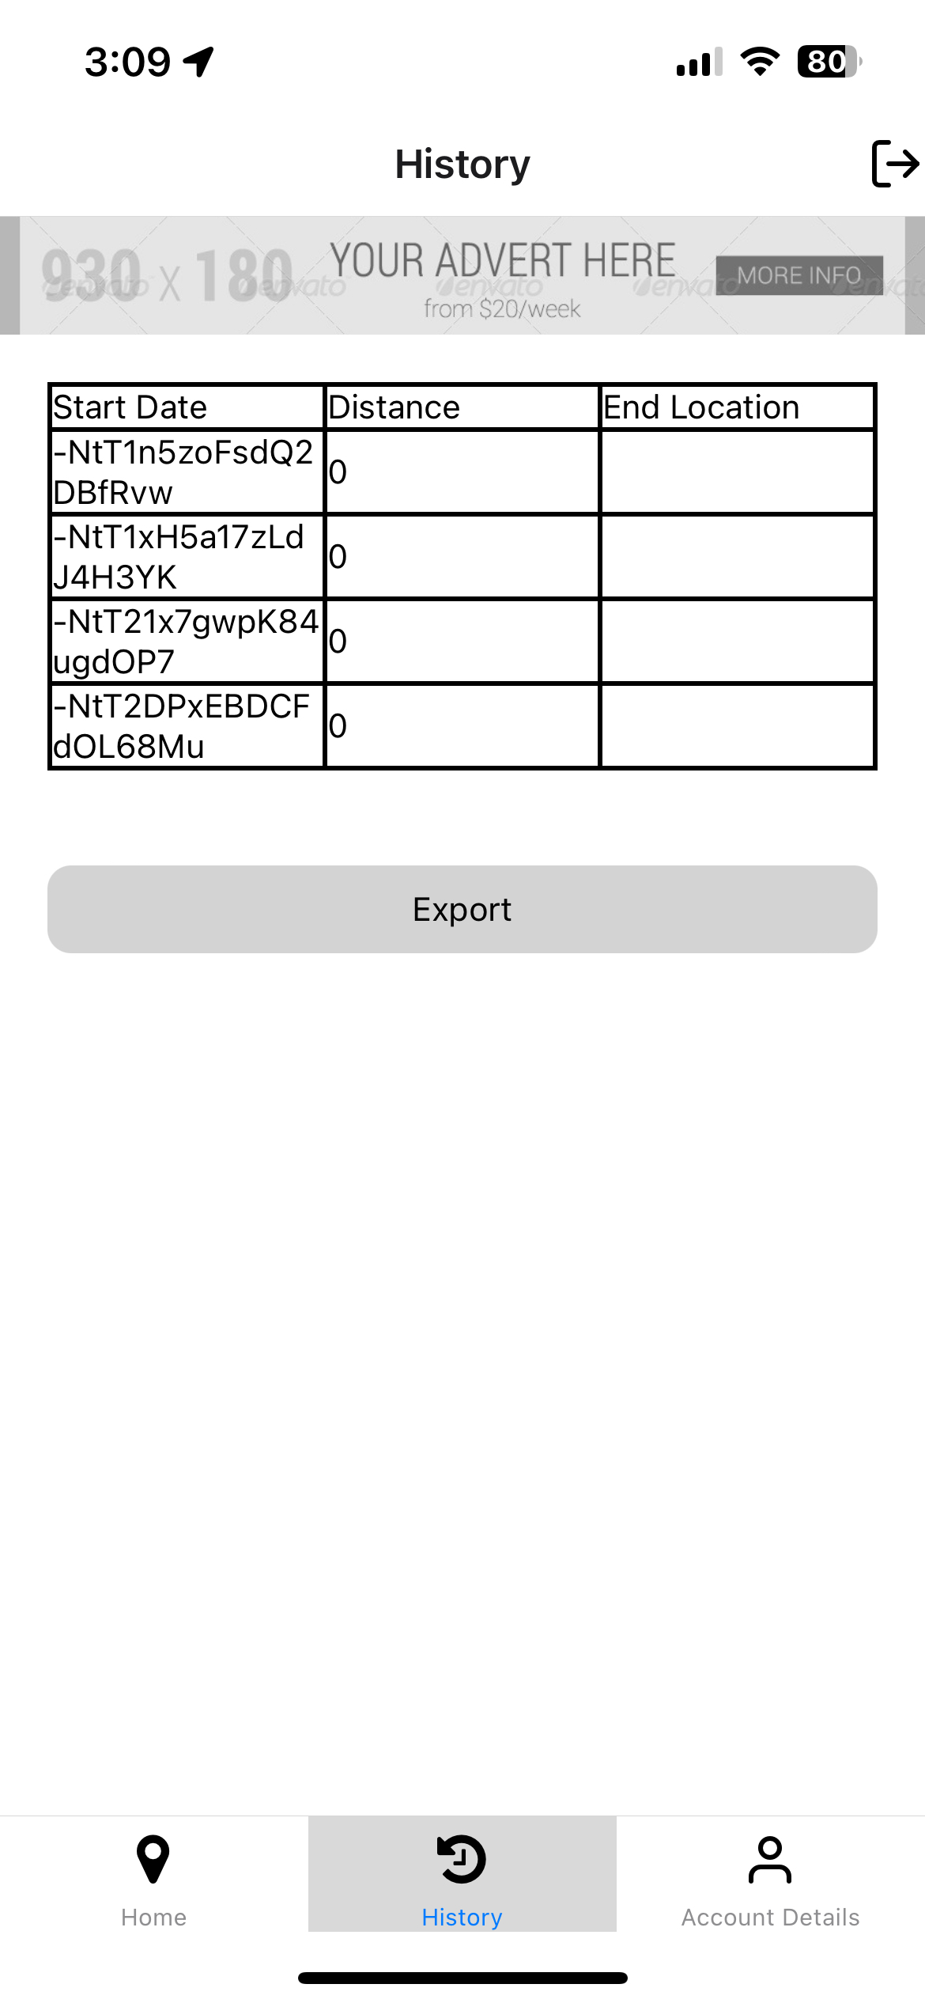
Current App Design

Slide 14

App Demo
https://youtu.be/jgwm7dAyKRw

